Slide 1
Employee Data Analysis using Excel
STUDENT NAME: POORNIMA.K
REGISTER NO: 122204023
DEPARTMENT:B.COM(C.S)
COLLEGE: Shri Krishnaswamy college for women

Slide 2
PROJECT TITLE
Employee Gender Analysis using Excel

Slide 3


AGENDA
Problem Statement
Project Overview
End Users
Our Solution and Proposition
Dataset Description
Modelling Approach
Results and Discussion
Conclusion
3/21/2024 Annual Review

Slide 4

PROBLEM STATEMENT
To analyze the gender distribution within an organization using Excel, providing insights into the diversity and representation of employees.

Slide 5

PROJECT OVERVIEW
When analyzing employee data, understanding the gender distribution can provide valuable insights into workplace diversity, potential biases, and HR strategies. Excel, with its powerful data manipulation capabilities, is an excellent tool for this task.

Slide 6

WHO ARE THE END USERS?
Employee gender analysis using Excel can provide valuable insights for various stakeholders within an organization. Here are some potential end users

Slide 7

OUR SOLUTION AND ITS VALUE PROPOSITION
Analyzing employee gender distribution within an organization to assess diversity and potential biases.

Slide 8
Dataset Description
Before we dive into the analysis, let's clarify the data structure. Assuming you have an Excel dataset with a column dedicated to employee gender, you can proceed with the following steps

Slide 9

THE "WOW" IN OUR SOLUTION
Gender diversity in the workplace has become a crucial factor in fostering innovation, creativity, and overall organizational success. Analyzing employee gender data can provide valuable insights into your company's composition, identify potential biases, and inform strategies for improving inclusivity.
3/21/2024 Annual Review
9

Slide 10
MODELLING
Excel modeling, ensure you have a dataset that includes the following information for each employee:
10

Slide 11
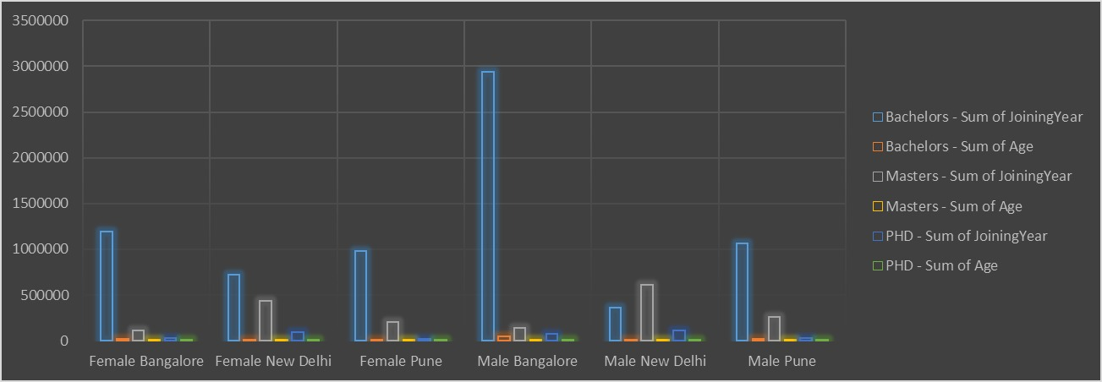
RESULTS
11

Slide 12
conclusion
To provide a more accurate and tailored conclusion, please share the specific findings from your Excel analysis

